Slide 1
Long Short-Term Memory
Sepp Hochreiter & Jürgen Schmidhuber (1997)
(Presented by Kelly Zhang)

Slide 2
Learning Sequences
Elman Nets (Vanilla RNN)
Difficulties:
Variable length inputs
Long time-lags (memory)
Approach:
Recurrence
New difficulties:
Vanishing error gradients through depth / time

Slide 3
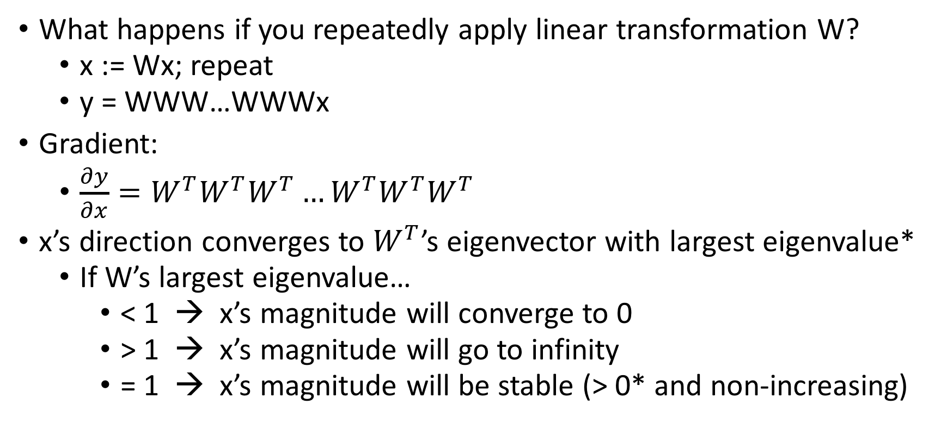
Recurrence at its Limits: Linear Case
What happens if you repeatedly apply linear transformation W?
x := Wx; repeat
y = WWW…WWWx
Gradient:
$\frac{∂y}{∂x}=W^{T}W^{T}{W^{T}…W}^{T}W^{T}W^{T}$
x’s direction converges to $W^{T}$’s eigenvector with largest eigenvalue*
If W’s largest eigenvalue…
< 1 → x’s magnitude will converge to 0
> 1 → x’s magnitude will go to infinity
= 1 → x’s magnitude will be stable (> 0* and non-increasing)
*Assuming x’s component in the direction of the eigenvector of the largest eigenvalue is non-zero

Slide 4
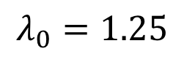
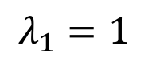
$$λ_{0}=1.25$$
$$λ_{1}=1$$

Slide 5
$$λ_{0}=1.25$$
$$λ_{1}=1$$

Slide 6
$$λ_{0}=1.25$$
$$λ_{1}=1$$

Slide 7
$$λ_{0}=1.25$$
$$λ_{1}=1$$

Slide 8
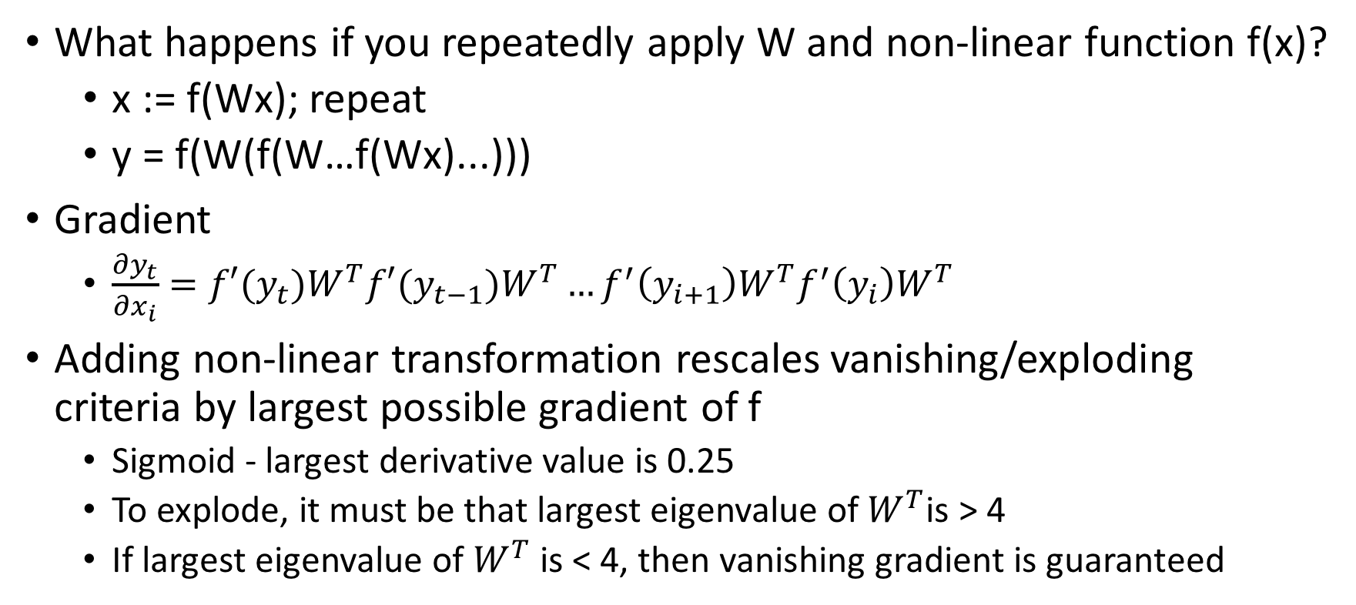
Recurrence at its Limits: Non-Linear Case
What happens if you repeatedly apply W and non-linear function f(x)?
x := f(Wx); repeat
y = f(W(f(W…f(Wx)...)))
Gradient
$\frac{∂y_{t}}{∂x_{i}}=f′(y_{t})W^{T}f′(y_{t−1})W^{T}…{f^{′}\left(y_{i+1}\right)W}^{T}f^{′}\left(y_{i}\right)W^{T}$
Adding non-linear transformation rescales vanishing/exploding criteria by largest possible gradient of f
Sigmoid - largest derivative value is 0.25
To explode, it must be that largest eigenvalue of $W^{T}$is > 4
If largest eigenvalue of $W^{T}$ is < 4, then vanishing gradient is guaranteed

Slide 10
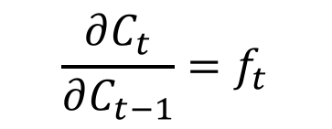
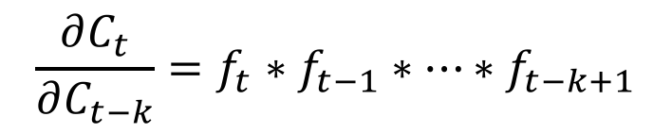
← GATE
$$\frac{∂C_{t}}{∂C_{t−1}}=f_{t}$$
← GATE
$$\frac{∂C_{t}}{∂C_{t−k}}=f_{t}∗f_{t−1}∗…∗f_{t−k+1}$$
← RECURRENT CELL
← GATE

Slide 11
Constant Error Carousel
Cell state
Previous hidden state
New hidden state
Input for current time-step

Slide 12
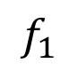
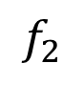
Error Flow through Cell State
$$f_{1}$$
$$f_{2}$$

Slide 13
Multiple Memory Blocks
Similar to learning multiple different LSTM cells
← LSTM output is a function of each block’s hidden state output
(From my understanding of the paper, the hidden states are added; let me know if I’m mistaken)
Each block has its own: - Cell and hidden states - Weights (f, i, & o gates, candidate)
← Shared Input Representation
Sounds like Recurrent Entity Networks

Slide 14
Techniques to Prevent Memory Redundancy
Original LSTM:
1) Add a new memory block whenever the performance of the model stops improving
2) Initialize the bias of the output gate for memory cells to negative values → encourages the activations of the output (hidden state) toward zero initially
The model can learn to “allocate” these memory cells over time by changing these bias values
Recurrent Entity Networks (Henaff et al. 2016):
Each memory block (LSTM unit) has a key, weights are tied with the word embeddings of certain chosen entities
Biases inputs related to the key to be written to that block

Slide 15
Wormholes: Sparsity in Memory Reads
Using REINFORCE for memory addressing
Scaling Memory-Augmented Neural Networks with Sparse Reads and Writes (Rae et al. 2016)
Using K-nearest neighbors for memory addressing
Memory Augmented Neural Networks with Wormhole Connections (Gulcehre et al. 2017)

Slide 16
Depth through Gates and Highways: A Mini Exploration

Slide 17
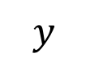
Highway Networks: Deeper Through Gates
$$y$$
Can train 900 layer deep models with SGD
Implicit version of residual networks
Residual Network
Srivastava et al. 2015
He et al. 2015

Slide 18
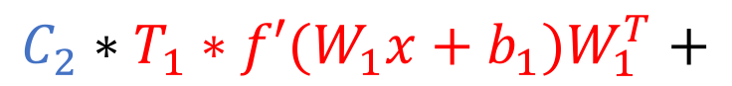
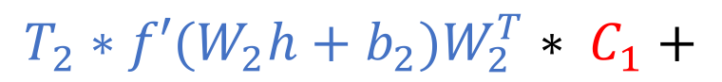
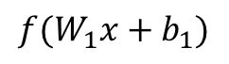
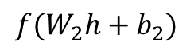
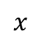
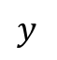
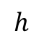
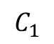
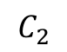
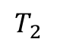
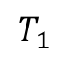
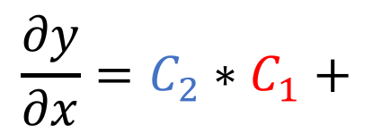
Highway Gradients
$$y$$
$$\frac{∂y}{∂x}=C_{2}∗C_{1}+$$
$$C_{2}$$
$$T_{2}$$
$${f(W}_{2}h+b_{2})$$
$$C_{2}∗T_{1}∗{f′(W}_{1}x+b_{1})W_{1}^{T}+$$
$$h$$
$$T_{2}∗{f′(W}_{2}h+b_{2})W_{2}^{T}∗ C_{1}+$$
$$C_{1}$$
$$T_{1}$$
$$T_{2}∗{{f′(W}_{2}h+b_{2})W_{2}^{T}∗T}_{1}∗{f′(W}_{1}x+b_{1})W_{1}^{T}$$
$${f(W}_{1}x+b_{1})$$
$$x$$

Slide 19
Recurrent Highway Networks
Adaptive Computation Time
^highway network
^highway network

Slide 20
Penn Treebank Language Modeling

Slide 21
Character level language modeling: Hutter Prize (Compressing Wikipedia)
Enwiki8 (27 unicode symbols)
Text8 (27 unicode symbols)
(Performance is measured in entropy bits per character. I am not sure what bits mean here exactly...)

Slide 22
Questions about Depth in RNNs
Is there a way to effectively add “depth” to tree / recursive neural networks?
What are stacked LSTM’s learning? Are they learning hierarchical structure? Interpretable?
How can we make neural networks explicitly learn hierarchical structure / chunking in sequences?
Adaptive Sequence Chunker (Schmidhuber 1992)
Hierarchical Multiscale Recurrent Neural Networks (Chung et al. 2017)
Learning to Compose (Yogatama et al. 2016) / Andrew & Sam

